Slide 1
Welcome

Slide 2
Sales in period Walmart

Slide 3
Objective:
Optimize Walmart's retail operations by leveraging data insights to enhance sales strategies, inventory management, and store-specific performance. Utilize SQL queries for targeted analyses, aiming for sustained success through informed decision-making in the dynamic retail market.

Slide 4
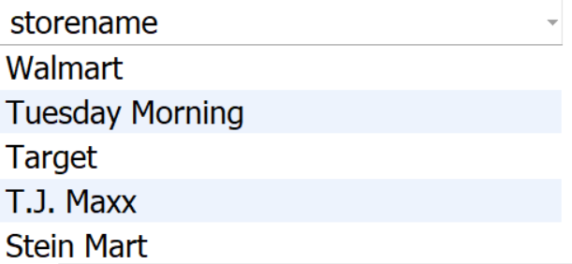
1 Retrieve the unique store names from the "Store" table
select distinct(storename)
from inventory;

Slide 5
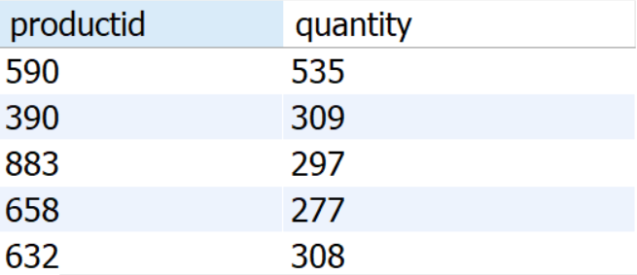
2.Retrieve the total quantity available for each product
select productid ,sum(quantity) as quantity
from sales
group by productid;

Slide 6
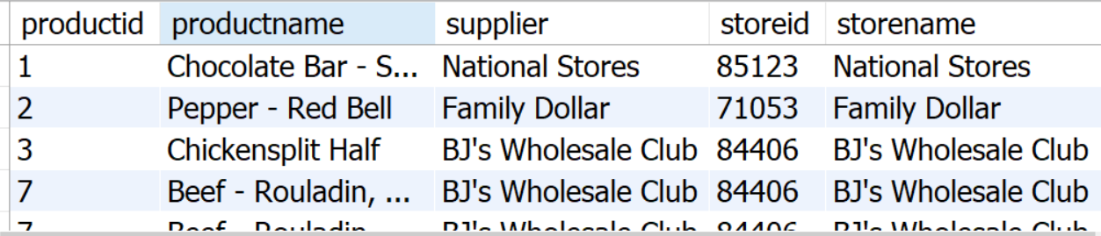
Retrieve the product details along with the corresponding store information
select p.productid,p.productname,
p.supplier,i.storeid,i.storename,
i.address
from products as p
inner join inventory as i
on p.productid = i.productid ;

Slide 7
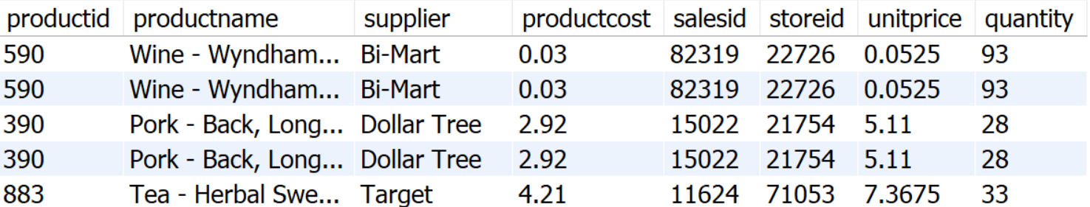
Retrieve the sales details including product and store information
select p.productid,p.productname,
p.supplier,p.productcost,s.salesid,
s.storeid,s.unitprice,s.quantity
from products as p
inner join sales as s
on p.productid = s.productid
inner join inventory as i
on p.productid = i.productid;

Slide 8
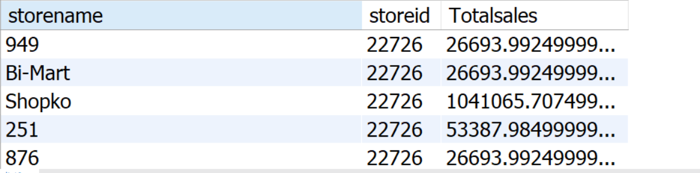
5.Find the total sales amount for each store
select i.storename,i.storeid ,
sum(s.unitprice * s.quantity)
as Totalsales
from sales as s
inner join inventory as i
on s.storeid = i.storied
group by i.storename,i.storeid;

Slide 9
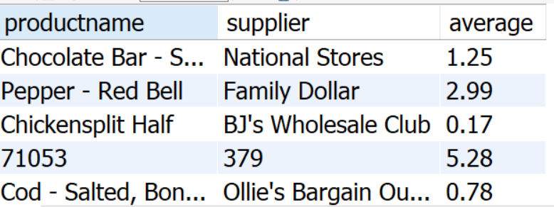
Find the average product cost for each supplier
select productname, supplier,
avg(productcost)as average
from products
group by supplier, productname;

Slide 10
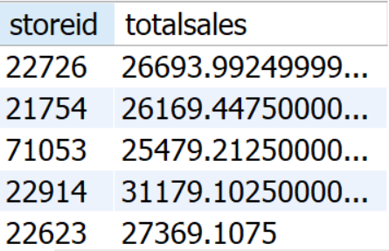
Find the stores where the total sales amount is greater than a specified value
select storeid,
sum(unitprice * quantity)
as Totalsales
from sales
group by storied
having Totalsales > 20000;

Slide 11
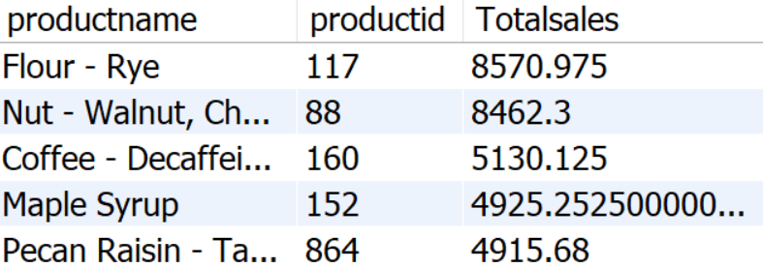
Products based on their total sales quantity in descending order
select p.productname,p.productid,
sum(unitprice * quantity)
as Totalsales
from products as p
left join sales as s
on p.productid = s.productid
group by p.productname,p.productid
order by totalsales desc;

Slide 12
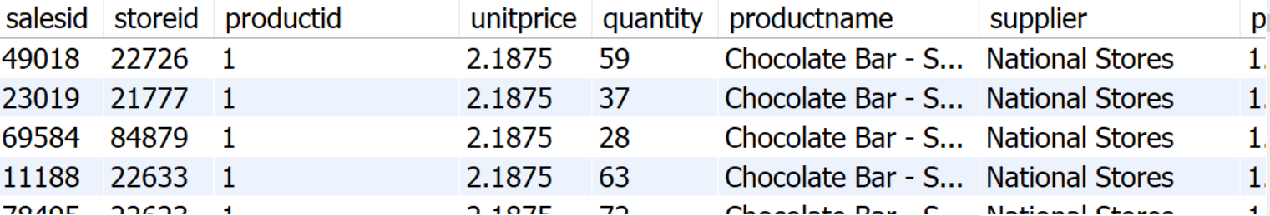
Retrieve all sales records, including those without corresponding products. Display sales details, product information, and indicate whether the product is missing (NULL) using a CASE statement.
select s.salesid,s.storeid,s.productid,
s.unitprice,s.quantity,p.productname,
p.supplier,p.productcost,
case
when p.productid is null then "missing“
else "found“
end as productstatus
from sales s right join products as p
on s.productid = p.productid;

Slide 13
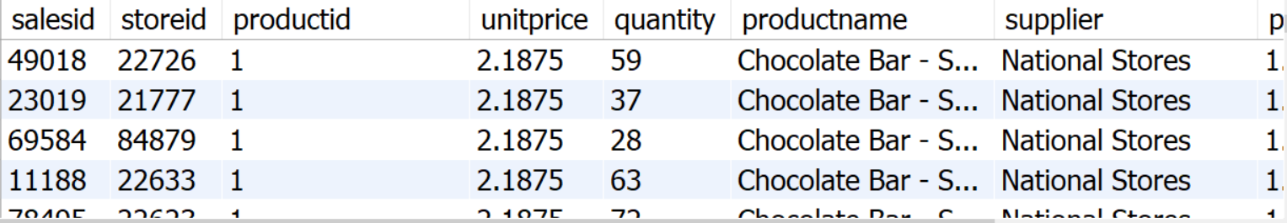
Retrieve the sales details for products with a quantity sold greater than the average quantity sold. Include products that have never been sold. Display sales information and product details.
select s.salesid,s.unitprice,
s.quantity,p.productid,p.productname,
p.supplier,productcost
from products as p
left join sales as s
on p.productid = s.productid
where s.quantity > (selectavg(quantity)from sales);

Slide 14
Conclusion
Analyzing Walmart's dataset revealed key insights, including high-performing stores, popular products, and effective inventory management. The use of SQL queries showcased the significance of data-driven decision-making for optimizing sales strategies and enhancing overall retail operations.

